Slide 1
The Spectrum of Teaching Styles:
How Have We Been Working with Future Physical Education Teachers
João Martins
jmartins@fmh.ulisboa.pt

Slide 2
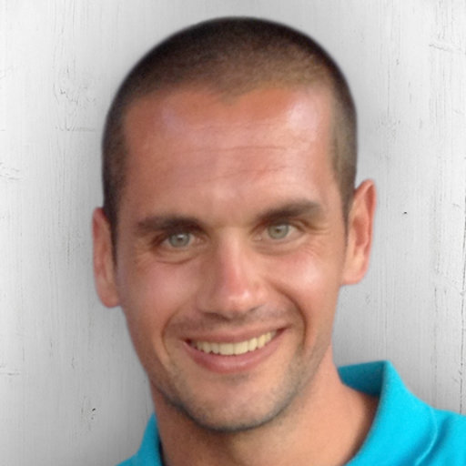
João Martins
Education
First degree (5-years) in sport sciences
Master in PE teaching in primary and secondary schools
Postgraduate (1-year) in data analysis in social sciences
PhD in Education – Didactics of PE and Sport
Master in epidemiology.
Professional experience
Lecturer at University (since 2010; 12 yrs)
Researcher (main interests: PE, PA, Physical literacy and the promotion of active lifestyles)
PE teacher
Vice-President of the Portuguese Society of Physical Education
Institutional Board Member of AIESEP
Spectrum colleague ;)

Slide 3
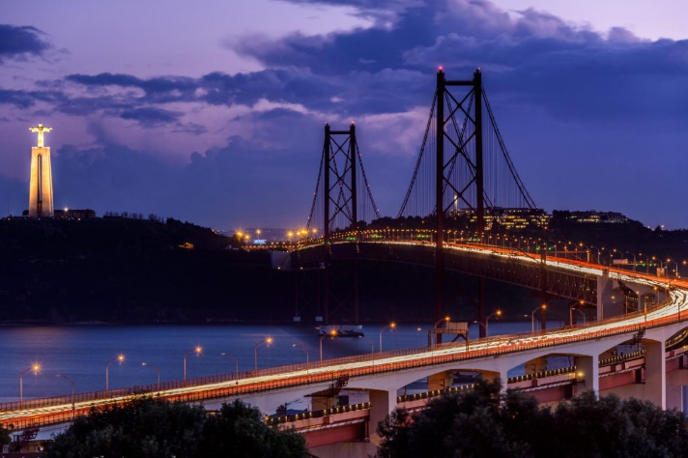
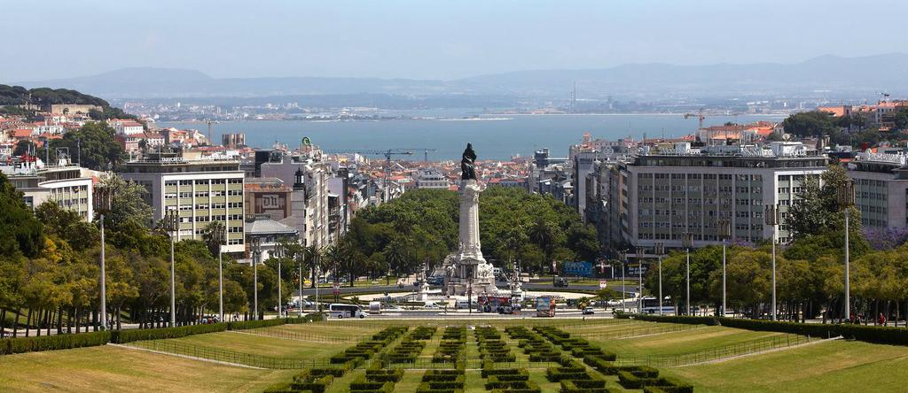
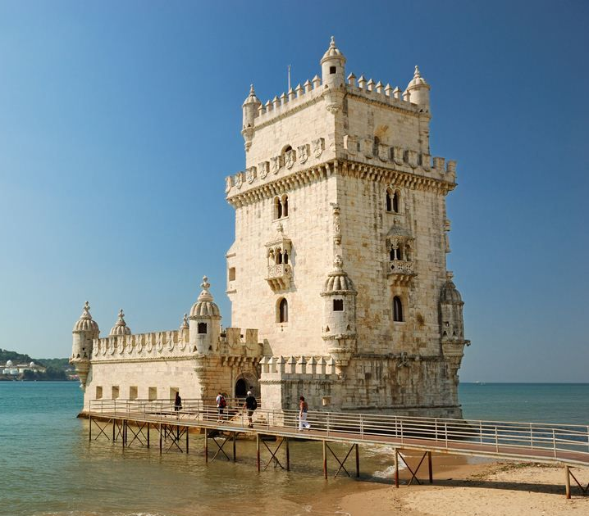
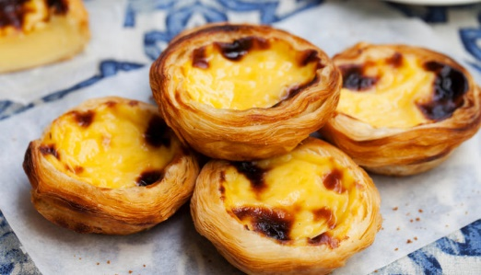
City of Lisbon

Slide 4
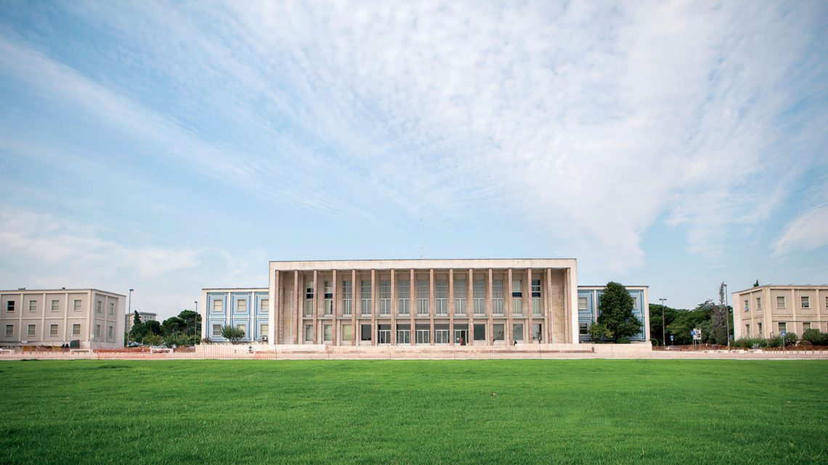
University of Lisbon
Schools and students
18 schools (several areas of knowledge)
~50 000 students
20 750 bachelor
13 969 bachelor with master
10 791 master
4 499 PhD
8 932 international students
11 509 graduates in 2018
3 730 Professors
~8 000 publications per year

Slide 5
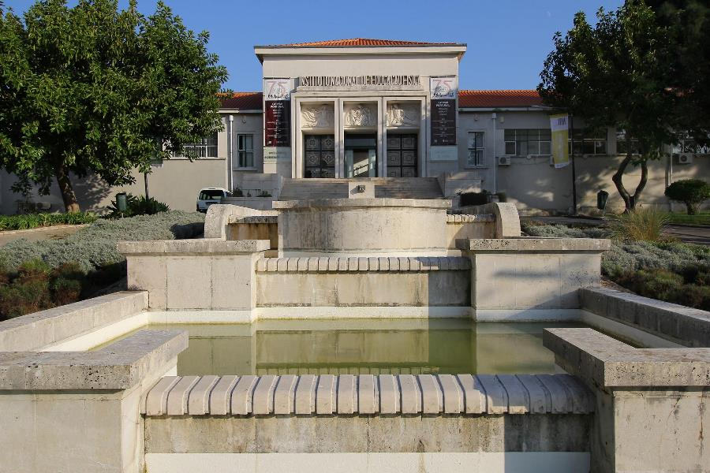
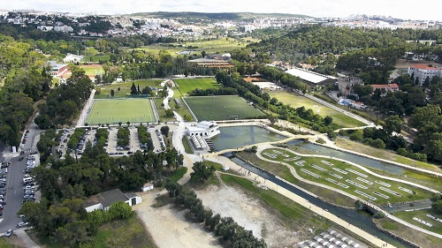
Faculty of Human Kinetics
Students and staff
School from the UL responsible to teaching and researching in the fields of PE, sport and human kinetics
80 years of history
2929 students (2018/2019)
1031 bachelor
650 master
217 PhD
130 Professors

Slide 6
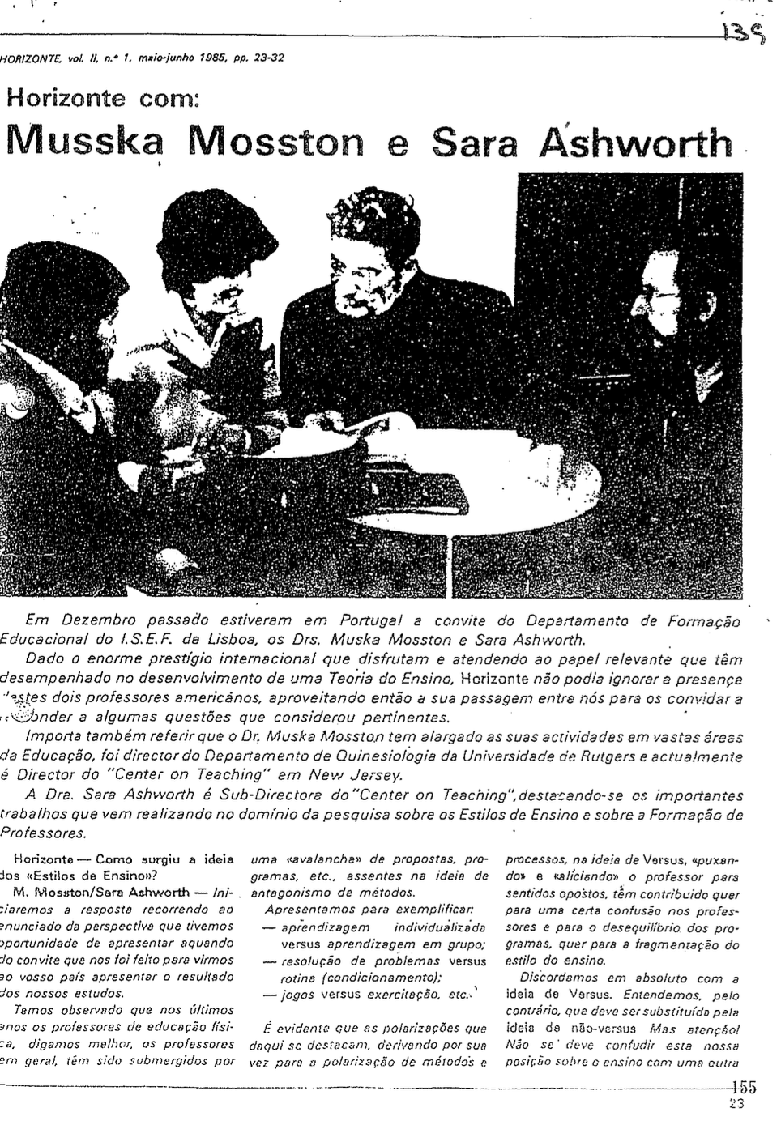
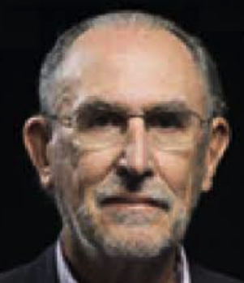
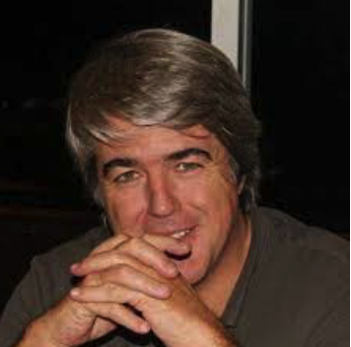
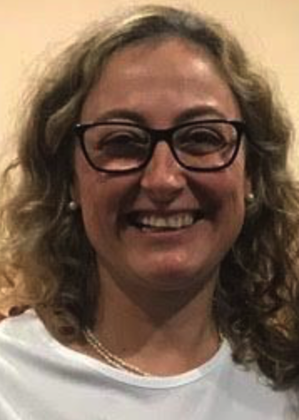
My relation with the spectrum
Learning & Applying in Practice
Teaching future PE students
Professor Francisco Carreiro da Costa
Dr. Marcos Onofre Dr. Lúcia Gomes
- 2011-2018 University of Lusófona
- 2015-2022 FMH-UL.
1985

Slide 7
Faculty of Human Kinetics
Study programs and where I teach the Spectrum
Bachelor (3 y)
Master (2y)
Postgraduation
PhD
Sport sciences
Dance
Sport management
Psychomotor rehabilitation
Teaching PE
Exercise and health
Ergonomy
Sport management
Psychomotor rehabilitation
Sports training
High performance training
High performance football coaching
Active ageing
Strength & conditioning
Dance training
…
Education
Human kinetics

Slide 8
Bachelor | Sport Sciences
Pedagogy of physical activities and sport III
>> Curricular unite, 3rd year, ~26-30 hours of teaching contact
Students learn about teaching strategies and The Spectrum.
Learning process: working sheets, video observations, exposition, critical reflection, collaborative work, micro-teaching episodes…
Assessment:
1. In group, plan a 60 min. lesson with a minimum of 2 styles (1 conv., 1 diverg.)
2. In group, teach the lesson to their peers using the 2 styles.
3. In group, develop a report: critical reflection of the lesson plan implementation (strengths, changes needed, …).
4. Individual Test.

Slide 9
Master | Teaching in PE
School Placement, 2nd year
1 year of teaching in real context in a public school, 1 class (grades 7-12)
4 areas of intervention:
1. Teaching
2. Action-research
3. School participation
4. Community relationships.
Teaching area
1 class, ~120 min to 180 min per week; ~2 classes/week)
Planning, conducting and evaluating
Using teaching styles in real teaching situations
Critical reflection, feedback peers, supervisors…

Slide 10
PhD | Education
Pedagogical principles and models in PE and Sport
Seminar, 5 hours teaching contact.
PhD Students learn about get to know The Spectrum and some research possibilities in this area.
Improve research in this area is needed !

Slide 11
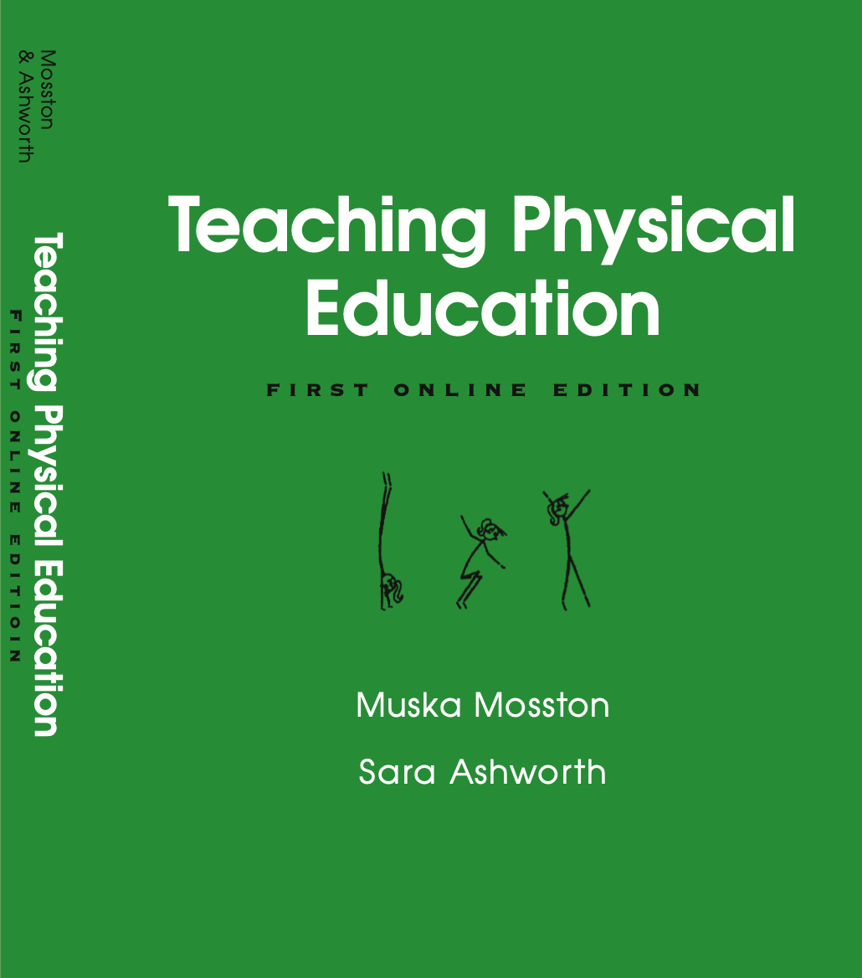
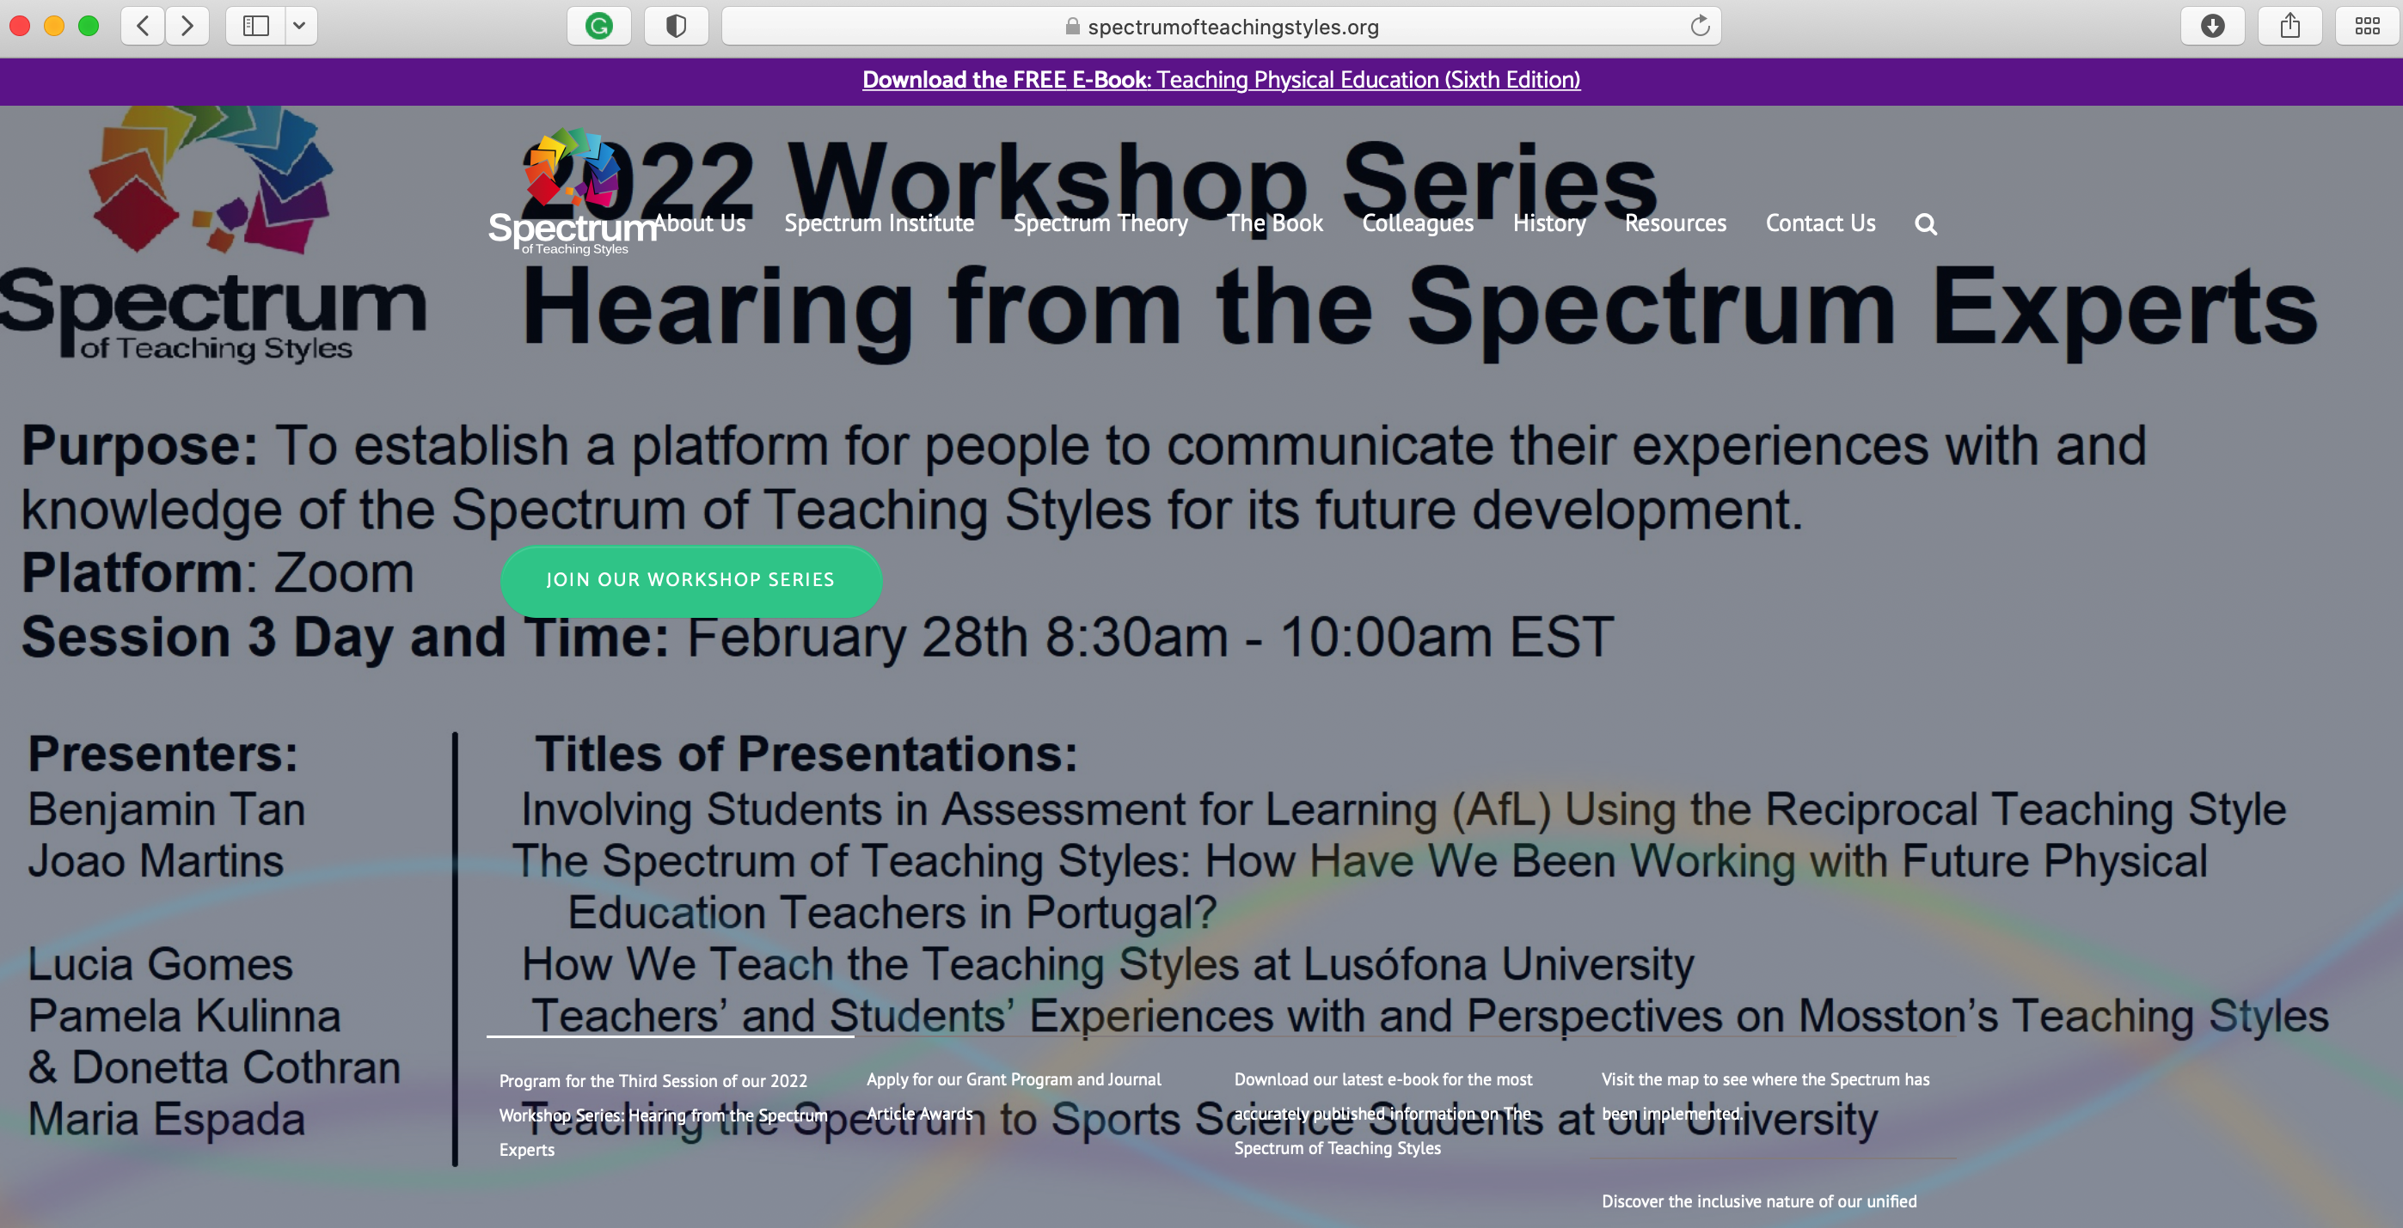
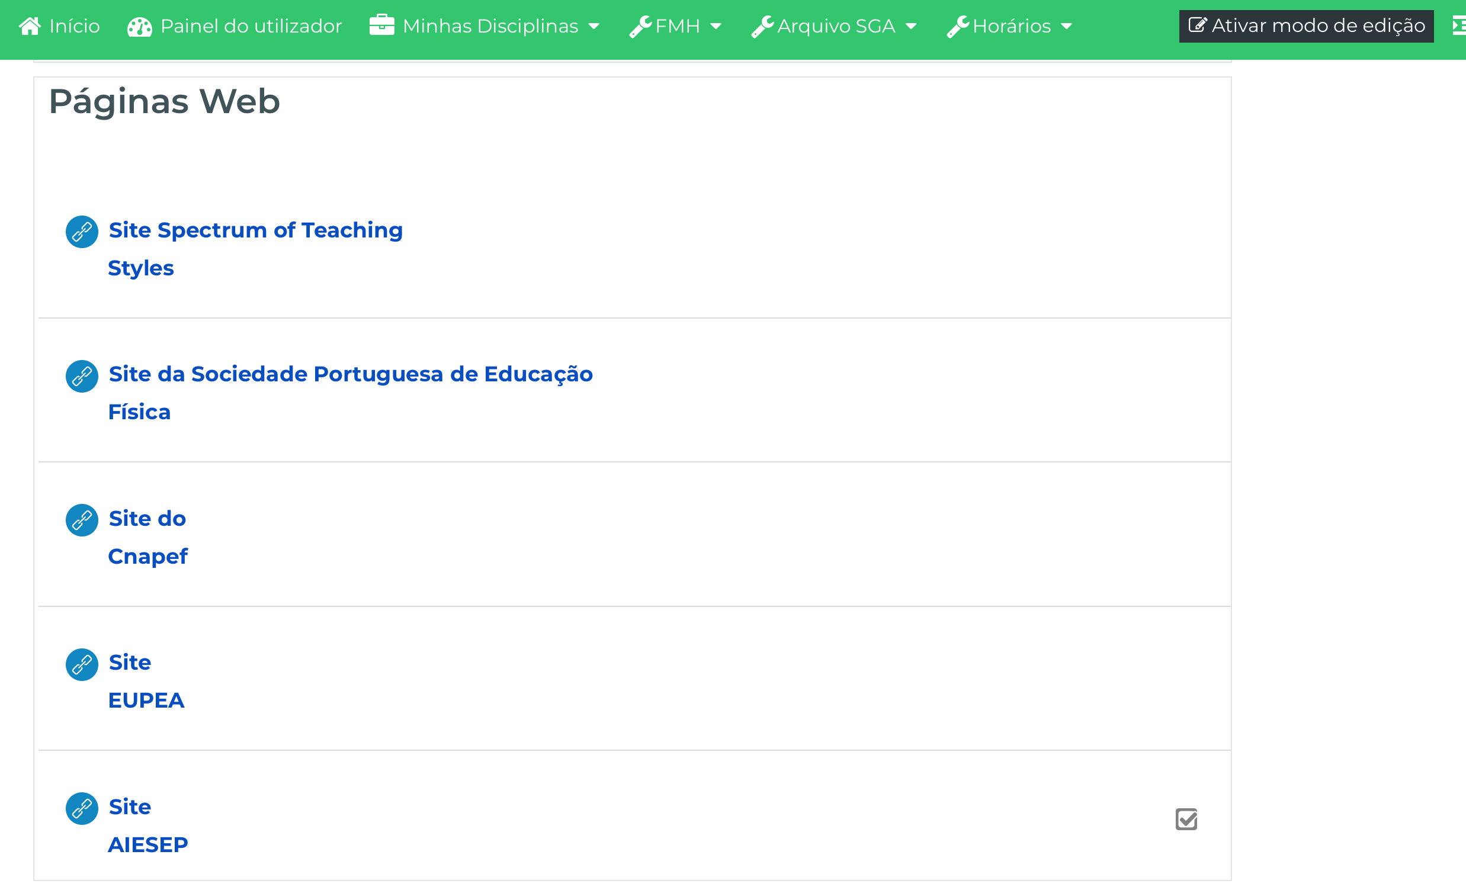
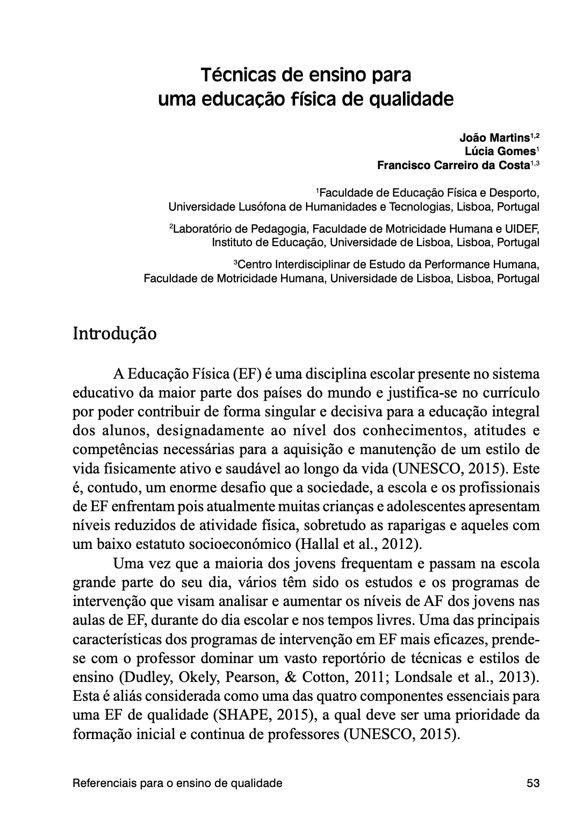
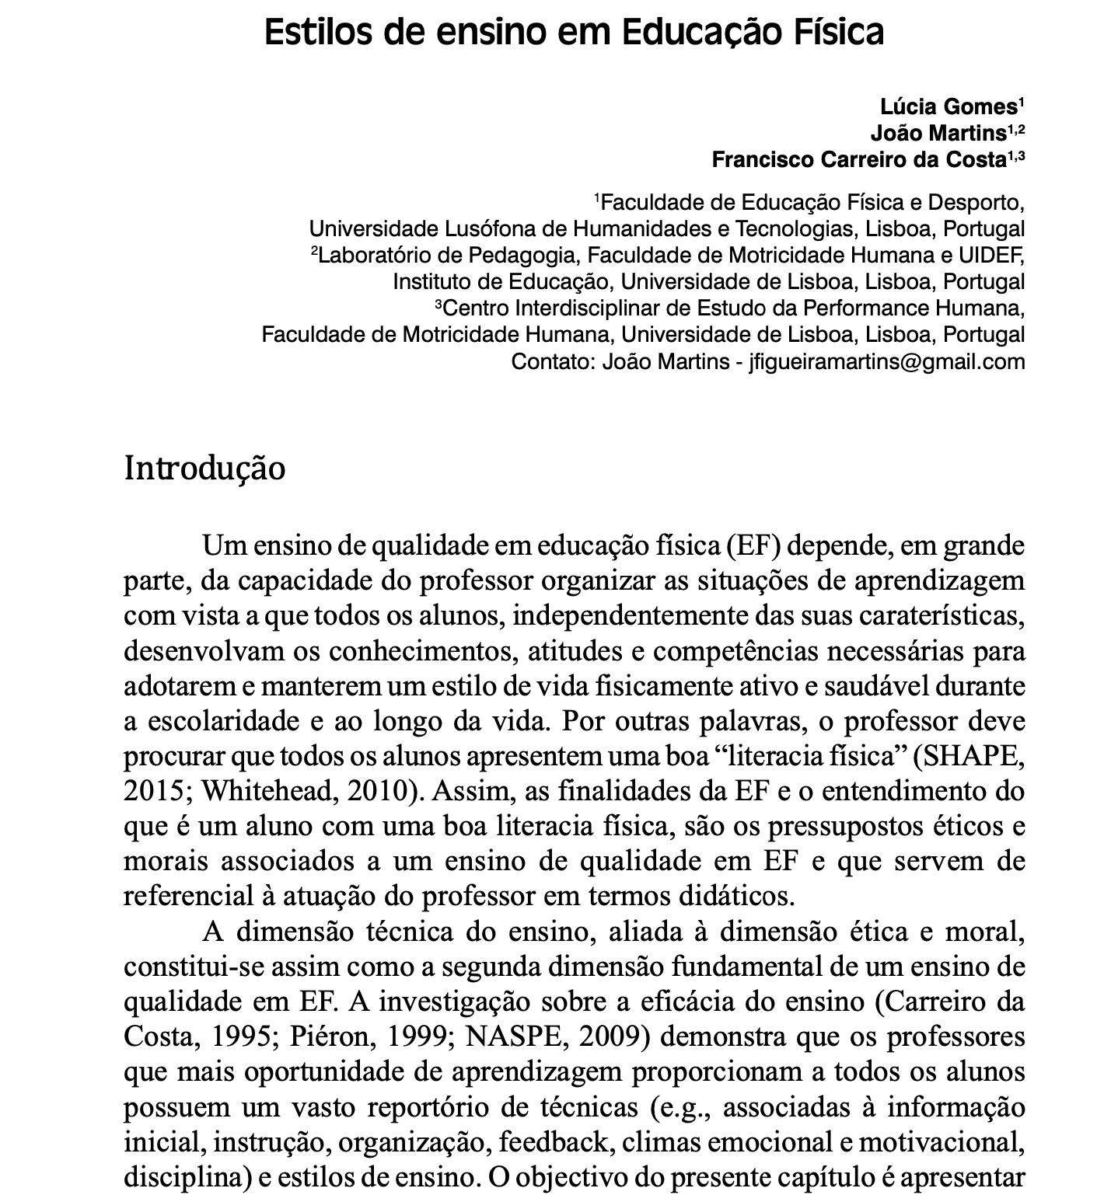
Knowledge Trasnfer Resources
Spectrum Website
Learning plataform
Vídeos
(Teacher + Students teachers)
Books
Book Chapters (PT + BR)

Slide 12
References
Gomes, L., Martins, J., & Carreiro da Costa, F. (2017). Estilos de ensino em educação física. In R. Catunda & A. Marques (Eds.), Educação física escolar: Referenciais para um ensino de qualidade (pp. 87-108). Belo Horizonte: Casa da Educação Física. [ISBN: 978-85-98612-49-2]
Martins, J., Gomes, L., & Carreiro da Costa, F. (2017). Técnicas de ensino para uma educação física de qualidade. In R. Catunda & A. Marques (Eds.), Educação física escolar: Referenciais para um ensino de qualidade (pp 53-82). Belo Horizonte: Casa da Educação Física. [ISBN: 978-85-98612-49-2].
Martins, M., Costa, J. & Onofre, M. (2020). Os Estilos de Ensino em Educação Física: entre a teoria e a prática. Edições FMH. [ISBN: 978-972-735-243-2].

Slide 13
Obrigado (thank you).
Questions and comments are welcome.
João Martins
jmartins@fmh.ulisboa.pt

